Slide 1
Medical Imaging Formats
DICOM and NIfTI

Slide 2
Installing New Libraries / Packages
pydicom for DICOM files
If using anaconda / miniconda:
conda install -c conda-forge pydicom nibabel
Anaconda also has a GUI for managing libraries
If using python.org:
pip install pydicom nibabel
(pip also works in Anaconda, but it can lead to clashes)
If using uv:
uv pip install pydicom nibabel
The “main” channel only has the most popular libraries
nibabel for NIfTI (and others…)

Slide 3
DICOM
The standard (imaging) format for medical imaging
Stores image data and study metadata
Mainly designed for compatibility and standardization
Very complex: has to be flexible enough to handle different vendors, modalities, metadata, etc.
Cannot handle raw data (e.g. CT sinogram, SPECT list mode, etc.) – those are usually proprietary formats
Most modalities output multiple DICOM files in 2D, even for n-D scans (e.g. for a 4D MRI volume+time)
In practice: usually convert from DICOM to a more “convenient” format for further processing

Slide 4
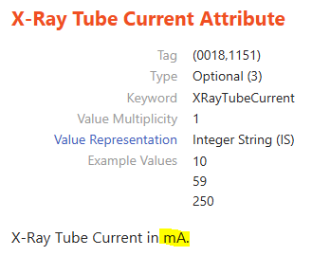
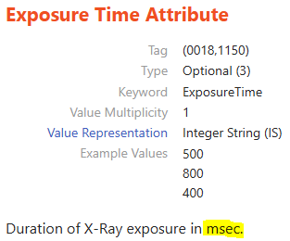
import pydicom
f = './data/xray-chest.dcm'
dcm = pydicom.dcmread(f)
print(dcm)
Location of the DICOM file
Print all the DICOM metadata
print(dcm['00081030'])
print(dcm['StudyDescription'])
print(dcm.StudyDescription)
print(dcm.get('StudyDescription'))
Different ways to access the metadata
Search the Internet for the DICOM tag definition
val = dcm.XRayTubeCurrent * dcm.ExposureTime
print(f"{val / 1000} mAs")

Slide 5
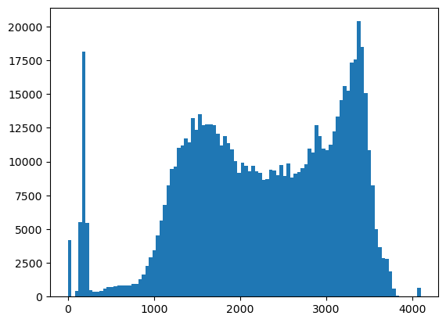
import matplotlib.pyplot as plt
img = dcm.pixel_array
print(img.shape) # rows (height), columns (width)
plt.imshow(img)
Image matrix
≈7.5 megapixels!
samples = img.flat[::10]
_ = plt.hist(samples, 100)
Sample by getting every 10th value
Colormap
_, (ax1, ax2) = plt.subplots(ncols=2)
ax1.imshow(img, vmin=700, vmax=2500, cmap='inferno')
ax2.imshow(img, vmin=2200, vmax=3600, cmap='inferno')
Different window/levels

Slide 6
What about loading 3D volumes (e.g. CT)?
Library for handling files and folders / directories / paths
from pathlib import Path
d_ct = Path("./data/ct-head")
f_lst = list(d_ct.glob("CT*"))
f_lst = sorted(f_lst)
print(f_lst)
Get all files named “CT*”
Sort in alphabetical order
import pydicom
dcm_lst = []
for f in f_lst:
dcm = pydicom.dcmread(f)
dcm_lst.append(dcm)
print(dcm_lst)
Load all the DICOM files into a list
How should we combine the 2D images → 3D volume?

Slide 7
import numpy as np
print(dcm_lst[0].ImagePositionPatient)
pos_lst = []
for dcm in dcm_lst:
pos_lst.append(dcm.ImagePositionPatient)
pos_all = np.stack(pos_lst)
print(pos_all)
Image x,y,z position in the “patient coordinate system”
Stack up into a single 32x3 matrix
dist = pos_all[0] - pos_all
print(dist)
Get the x,y,z distance compared to the first position
dist = dist[:, 2]
print(dist)
In this specific case, it’s obvious the scans are captured along the z-axis

Slide 8
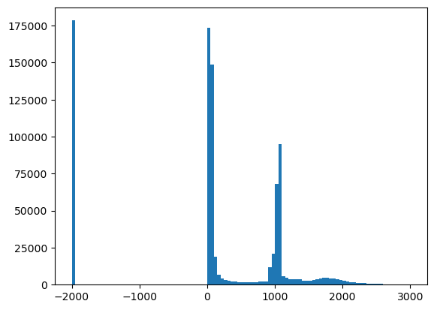
idx = np.argsort(dist)
print(idx)
print(dist[idx])
Get the indexes in ascending order
img_lst = []
for n in idx:
img = dcm_lst[n].pixel_array
img_lst.append(img)
vol = np.stack(img_lst, axis=2)
print(vol.shape)
Get the 2D images in order …
… and stack them into a 3D volume
import matplotlib.pyplot as plt
samples = vol.flat[::10]
_ = plt.hist(samples, 100)
Air?
Soft tissue?
Sample every 10th value and get histogram
Bone?

Slide 9
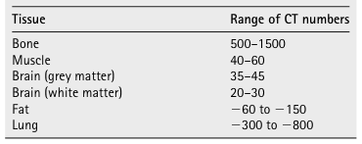
print(dcm.RescaleSlope)
print(dcm.RescaleIntercept)
vol = vol.astype(float)
vol = vol * dcm.RescaleSlope + dcm.RescaleIntercept
samples = vol.flat[::10]
_ = plt.hist(samples, 100)
Convert to floating point
Rescale to HU / CT numbers
_, ax_lst = plt.subplots(nrows=4, ncols=8, dpi=300)
n = 0
for n_row in range(4):
for n_col in range(8):
ax = ax_lst[n_row][n_col]
img = vol[:, :, n]
ax.set_axis_off()
ax.imshow(img, vmin=10, vmax=55, cmap='gray')
n += 1
Make figure higher res.
Window / level to ≈ brain tissue HU

Slide 10
print(dcm.PixelSpacing)
print(dcm.SliceThickness)
print(dist[idx])
The resolution is not isotropic
Multi-planar recontruction (sagittal view)
_, ax_lst = plt.subplots(nrows=4, ncols=8, dpi=300)
n = 0
for n_row in range(4):
for n_col in range(8):
ax = ax_lst[n_row][n_col]
img = np.rot90(vol[:, n, :], k=3)
ax.set_axis_off()
ax.imshow(img, vmin=10, vmax=55, cmap='gray',
aspect=5/0.43)
n += 16
Slice at a different plane
Rotate view
Set aspect ratio to account for resolution difference
Only show every 16th slice

Slide 11
NIfTI
Neuroimaging Informatics Technology Initiative
Research format designed for 3D/4D medical imaging data
Advantages: single file stores the entire volume
Disadvantages: very limited metadata support (not even patient or study name!)
Use 3rd party software to convert DICOM to NIfTI
E.g., dcm2nii, mriconvert, etc.
Python library nibabel supports NIfTI

Slide 12
NIfTI metadata is more limited
import nibabel as nib
nii = nib.load('./data/mri-heart.nii.gz')
print(nii)
vol = nii.get_fdata()
print(vol.shape)
NIfTI can store 3D/4D volumes
print(nii.header['pixdim'])
In NIfTI, the x,y,z,t spacing / resolution info starts from index 1 (index 0 is for the qfac sign bit)

Slide 13
import numpy as np
import matplotlib.pyplot as plt
samples = vol.flat[::10]
_ = plt.hist(samples, 100)
plt.yscale("log")
Set histogram to log-scale
_, ax_lst = plt.subplots(nrows=4, ncols=4, dpi=300)
n = 0
for n_row in range(4):
for n_col in range(4):
ax = ax_lst[n_row][n_col]
img = np.rot90(vol[:, :, n])
ax.set_axis_off()
ax.imshow(img, vmin=0, vmax=1500, cmap='gray')
n += 6
Rotate 90°
Only show every 6th slice

Slide 14
We haven’t yet properly accounted for spatial resolution, relative positioning, orientation, or 4D (temporal) data, but this should be enough in many cases.

